Slide 1

Theory of Automata & Formal Languages
Sir Syed University of Engineering & Technology, Karachi

Slide 2
Course Outline
Finite Automata(FA) (Deterministic FA and Non-Deterministic FAs.
Regular expressions,
Transition Graph (TG)
concepts of Regular Languages and Finite Automata;
Transducers (automata with output)Moore and Mealy Machines,
Non-regular Languages;.
Context-free Grammar and Languages;
Decidability for Context-free Languages;
Non-context-free Languages; Pushdown Automata,
Introduction to Turing machines.

Slide 3
Course Organization
Text Book:
Denial I. A. Cohen Introduction to Computer Theory, Second Edition, John Wiley & Sons.
Reference Books:
Automata, Computability and Complexity: Theory and Applications, by Elaine Rich.
Assessment Detail
Sessional 20%
Assignments
Quizzes
Midterm Examination 30%
Final Examination 50%

Slide 4
What is Automata?
The term "Automata" is derived from the Greek word "αὐτόματα" which means "self-acting".
An automaton (Automata in plural) is an abstract self-propelled computing device which follows a predetermined sequence of operations automatically.

Slide 5
What is automata theory?
Automata theory is the study of “abstract computational devices”
Abstract devices are (simplified) models of real computations
Computations happen everywhere: On your laptop, on your cell phone, in nature, …

Slide 6
History
Alan Turing defined machines more powerful than any in existence, or even any that we could imagine – Goal was to establish the boundary between what was and was not computable.
1930s
“Finite automata” machines studied
Noam Chomsky proposes the “Chomsky Hierarchy” for formal languages
1940-1950s
1960--
A convergence of all this into a formal theory of computer science, with very deep philosophical implications as well as practical applications (compilers, web searching, hardware, A.I., algorithm design, software engineering,…)

Slide 7
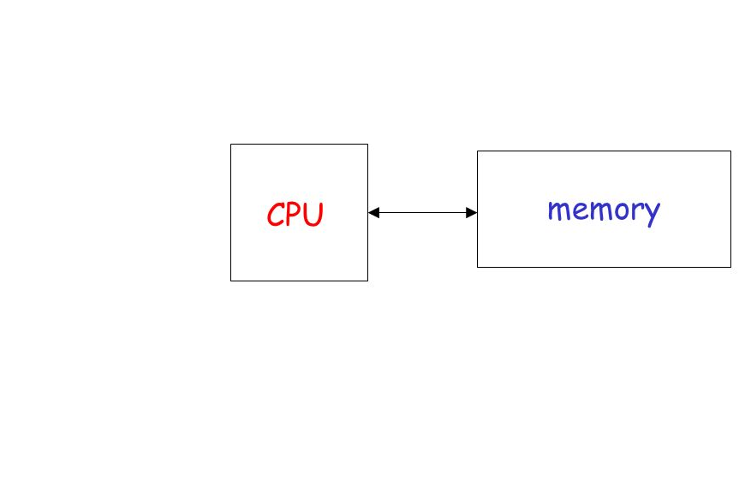
Computing example

Slide 8
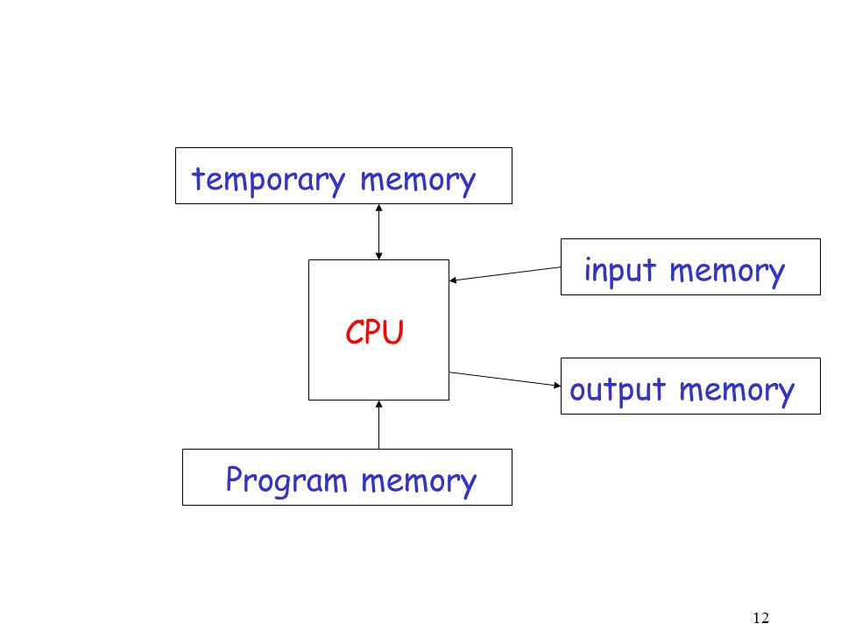

Slide 9
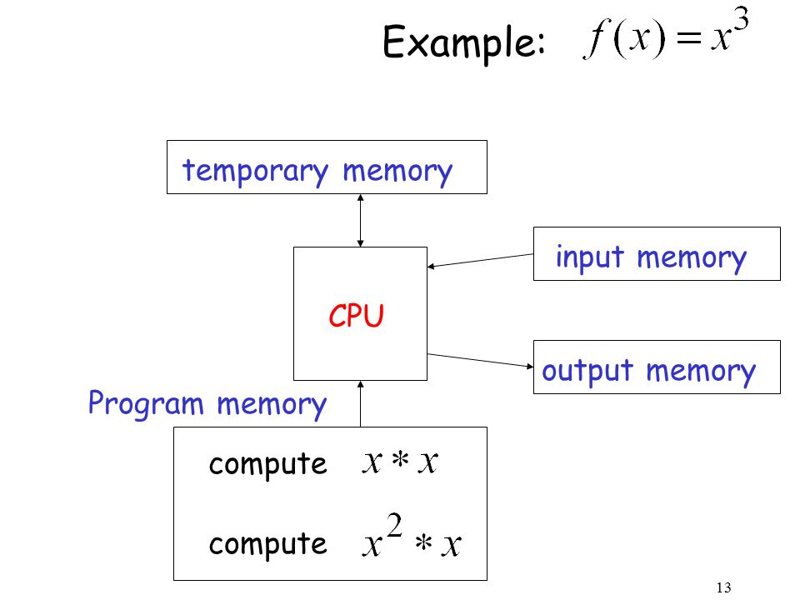

Slide 10
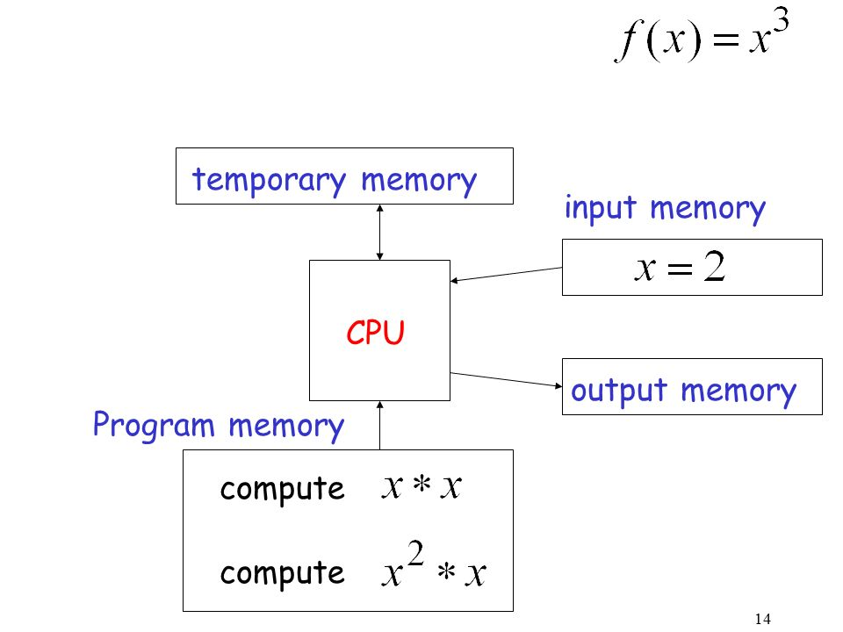

Slide 11
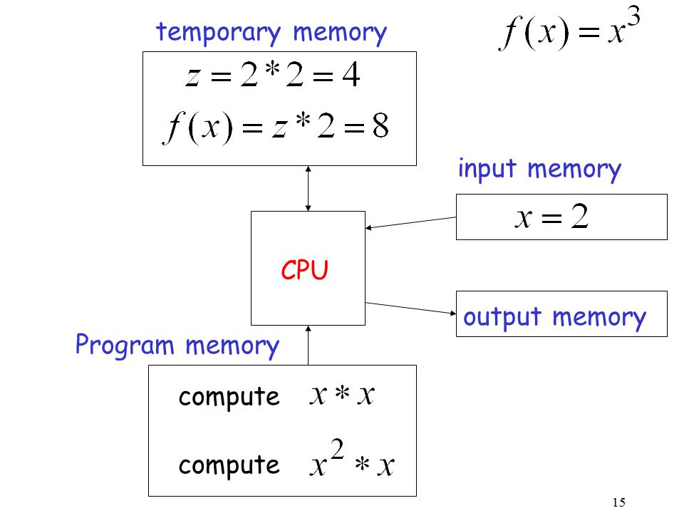

Slide 12
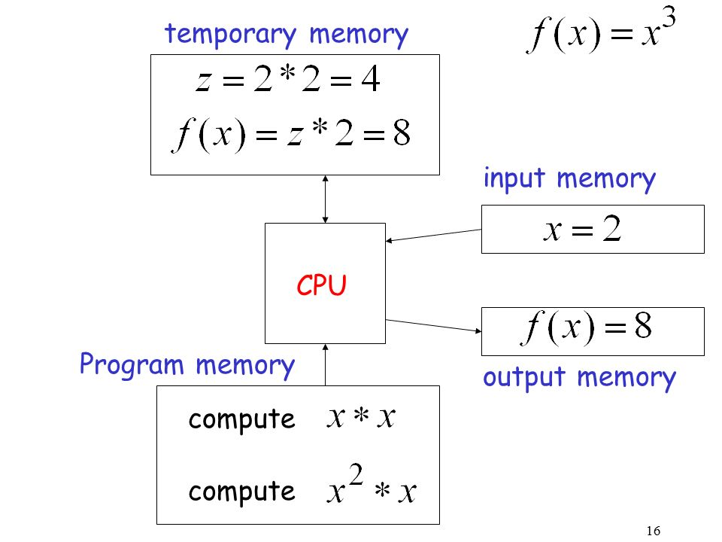

Slide 13
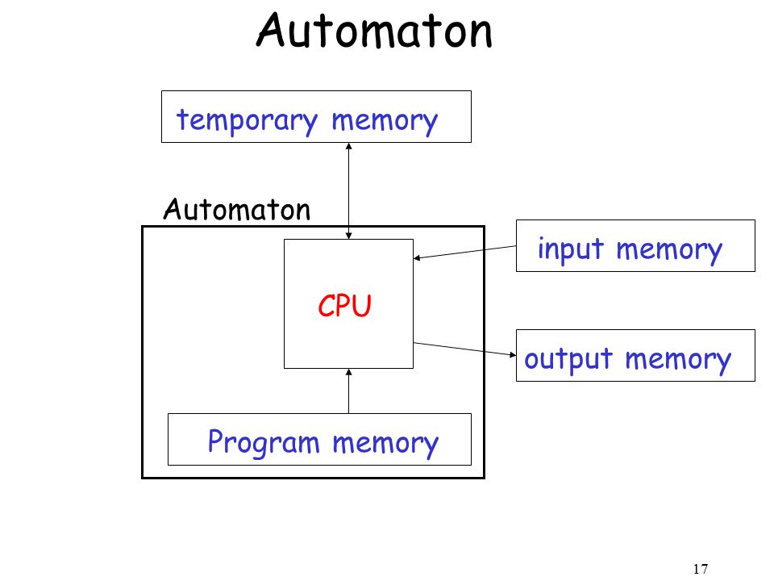

Slide 14
Some Applications
Software for designing and checking the behavior of digital circuits
Lexical analyzer of a typical compiler
Software for scanning large bodies of text (e.g., web pages) for pattern finding
Software for verifying systems of all types that have a finite number of states (e.g., stock market transaction, communication/network protocol)
Artificial Intelligence Applications
NLP
Deep Learning / Machine Learning
Computer Vision

Slide 15
Alphabets and strings
A common way to talk about words, number, pairs of words, etc. is by representing them as strings
To define strings, we start with an alphabet
Examples
S₁ = {a, b, c, d, …, z}: the set of letters in English
S₂ = {0, 1, …, 9}: the set of (base 10) digits
S₃ = {a, b, …, z, #}: the set of letters plus the special symbol #
S₄ = {(, )}: the set of open and closed brackets
An alphabet is a finite set of symbols.

Slide 16
A string over alphabet S is a finite sequence of symbols in S.
Examples
abfbz is a string over S₁ = {a, b, c, d, …, z}
9021 is a string over S₂ = {0, 1, …, 9}
ab#bc is a string over S₃ = {a, b, …, z, #}
))()(() is a string over S₄ = {(, )}
The empty string will be denoted by e or ε

Slide 17
A language is a set of strings over an alphabet.
Languages can be used to describe problems with “yes/no” answers, for example:
L₁ = The set of all strings over S₁ that contain the substring “fool”
L₂ = The set of all strings over S₂ that are divisible by 7 = {7, 14, 21, …}
L₃ = The set of all strings of the form s#s where s is any string over {a, b, …, z}
L₄ = The set of all strings over S₄ where every ( can be matched with a subsequent )

Slide 18
Types of Automata.
Automata are distinguished by the temporary memory
Finite Automata: no temporary memory
Used to model “small” computers
Pushdown Automata: stack
Devices with infinite memory that can be accessed in a restricted way.. Use to model parser.
Turing Machines: random access memory
Devices with infinite memory. Used to model any computer.

Slide 19
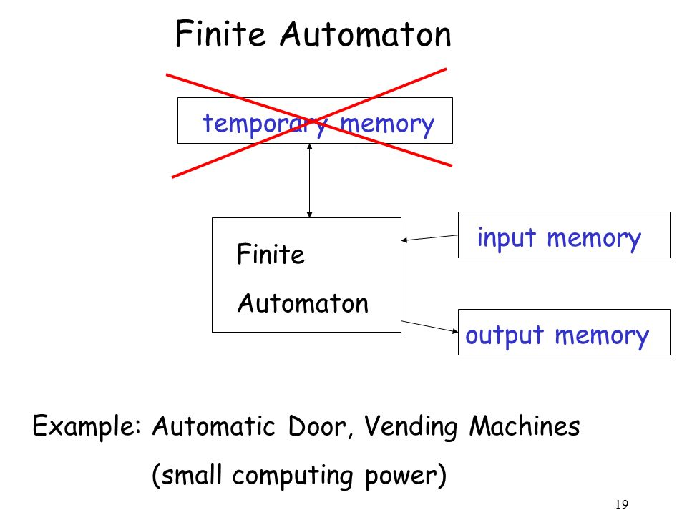

Slide 20
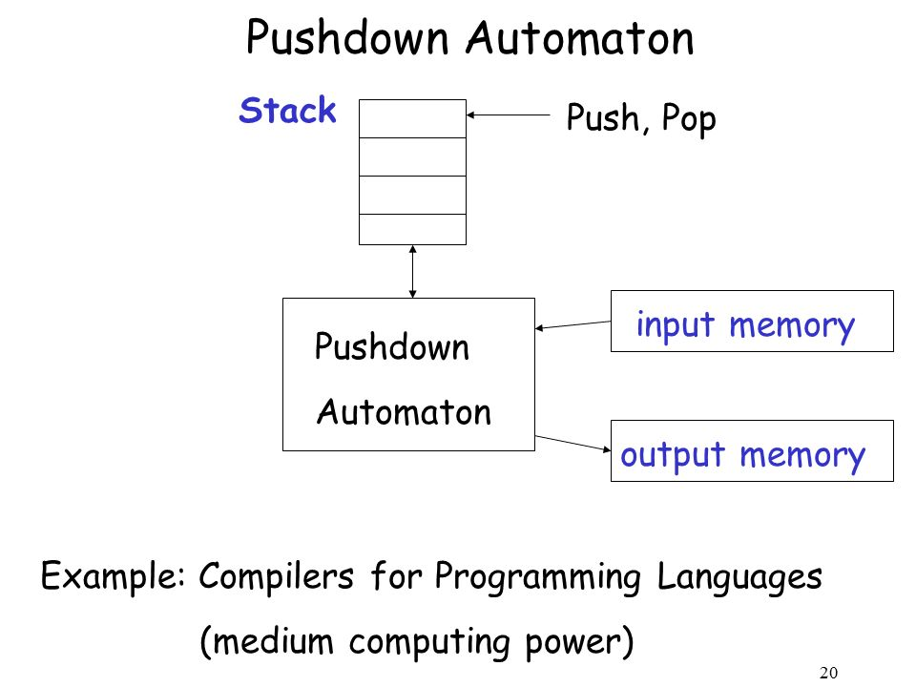

Slide 21
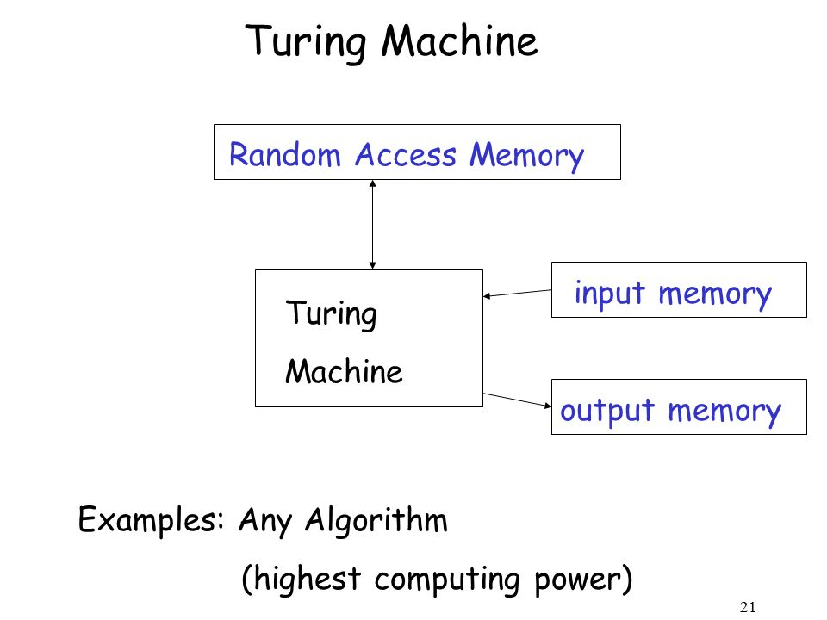

Slide 22
Power Of Automata
Finite
Automata
Push down
Automata
Turing Machine
Less Power
More Power
Solve More
Computational Problem

Slide 23
Finite Automata
An automata with a finite number of states is called a Finite Automata (FA) or Finite State Machine (FSM)
An automaton can be represented by a 5-tuple (Q, ∑, δ, q₀, F), where −
Q is a finite set of states.
∑ is a finite set of symbols, called the alphabet of the automaton.
δ is the transition function.
q₀ is the initial state from where any input is processed (q₀ ∈ Q).
F is a set of final state/states of Q (F ⊆ Q).

Slide 24
A simple computer
SWITCH
f
start
off
on
BATTERY
f
input:
output:
actions:
states:
switch
bulb is on if and only if there was an odd number of flips
Light bulb
Flip switch
On, off

